Slide 1
Data Structures Workshop
Day 23

Slide 2
Workshop Outline
AVL Trees
What Are They, Why Are They Used?
Benefits Over BST’s
Balance Factor
Insertion, Deletion Methods

Slide 3
AVL Trees

Slide 4
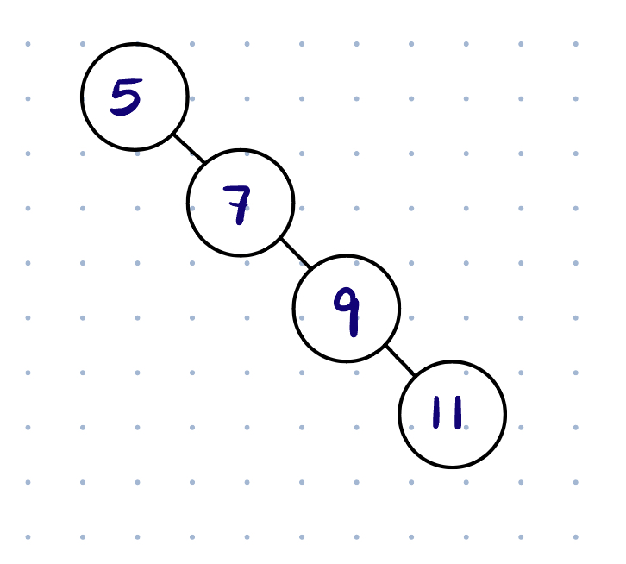
RECALL: BST Worst Case Performance
Ex. Search for “11”
By nature of the BST, in some cases, insertion into the BST is not balanced
Here, we see the search of the value “11” will run along the height of our tree, which is “n” nodes → O(n)

Slide 5
Is There Room for Improvement?
Here, we see that the worst case scenario in terms of performance for a Binary Search Tree behaves linearly.
There is an optimization we can make though, doing this will ensure an average logarithmic time complexity for operations.

Slide 6
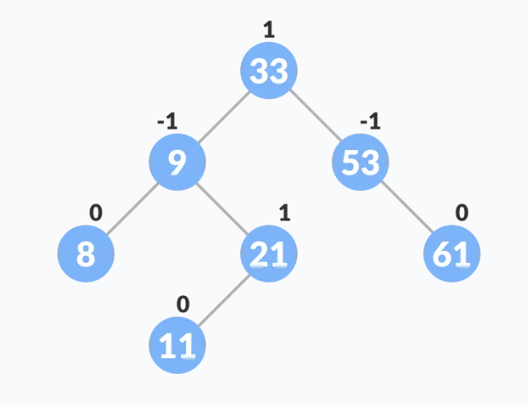
AVL Trees
An AVL tree is a self-balancing Binary Search Tree in which every node contains something called a “balance factor”.
The balance factor of a given node should always be -1, 0 or 1.
The self balancing property of an AVL tree is maintained by this balance factor.

Slide 7
Balance Factor
The balance factor of a given node is calculated as so:
Height of Left Subtree - Height of Right Subtree
At what balance factor value should our AVL start rebalancing?
When the absolute value of a node’s balance factor is greater than 1, the AVL tree will go through its rebalancing process.

Slide 8
AVL Rebalancing Cases
In order for our AVL tree to remain balanced at all times, there are certain operations we must implement to correct our AVL tree when it becomes unbalanced, we call these operations “rotations”.
Single Rotations:
Left Left Case (Rotate Right)
Right Right Case (Rotate Left)
Double Rotations:
Left Right Case (Rotate Left , then Rotate Right)
Right Left Case (Rotate Right, then Rotate Left)

Slide 9
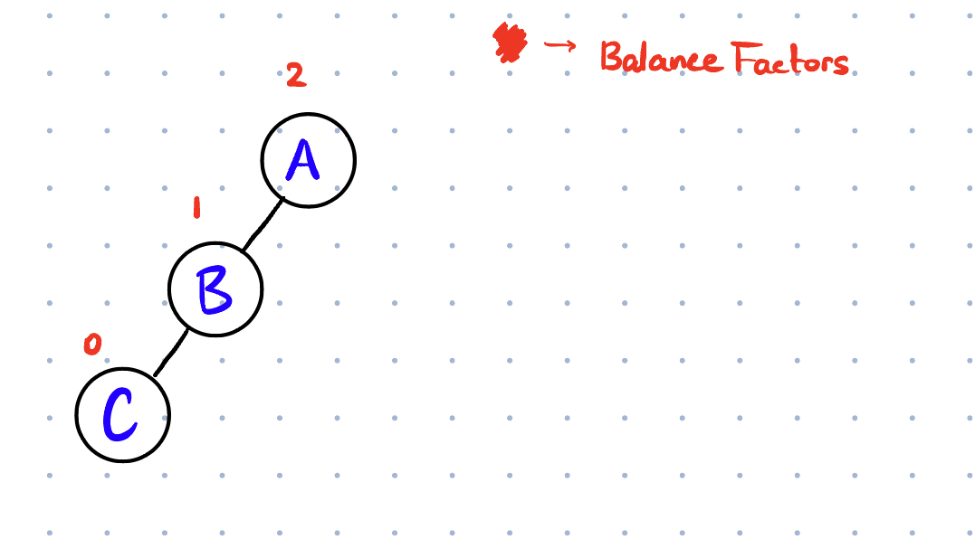
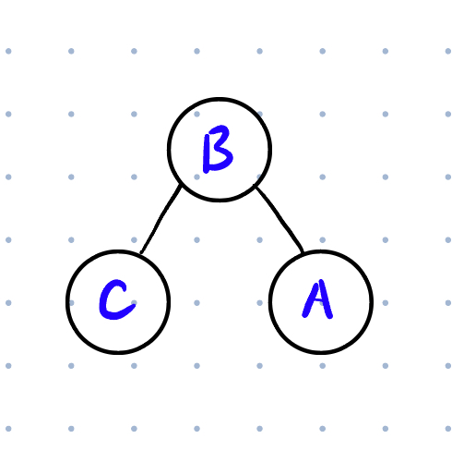
Right Rotation (Single)
Occurs when we insert to into a node’s left subtree, leading to an unbalanced tree.
We fix this by shifting the entire tree to the right.
Node A has BF violation. A will become the new right child to B, the new parent node. Shift A to right, make B new parent
→

Slide 10
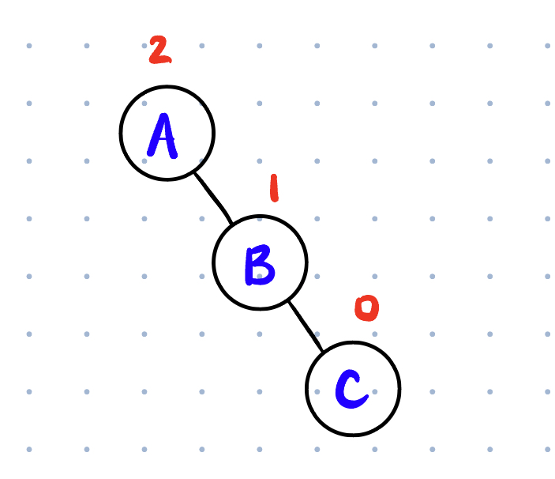
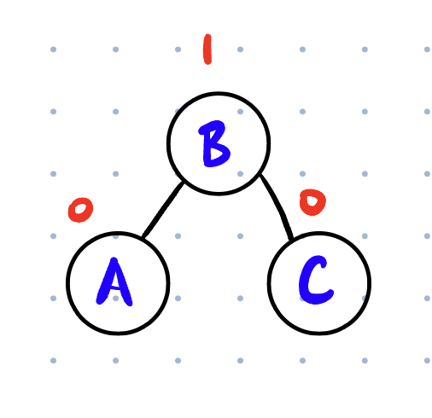
Left Rotation (Single)
Occurs when we insert to into a node’s right subtree, leading to an unbalanced tree.
We fix this by shifting the entire tree to the left.
→

Slide 11
Left Right Rotation (Double)
This rotation is performed when a node is inserted to the right subtree of a node’s left subtree, leading to an unbalance.
Again, in this case, we perform 2 different (single) rotations.
First, we perform a Left Rotation on the parent node’s child.
Then, we perform a Right Rotation on the parent node (Left Left Case)

Slide 12
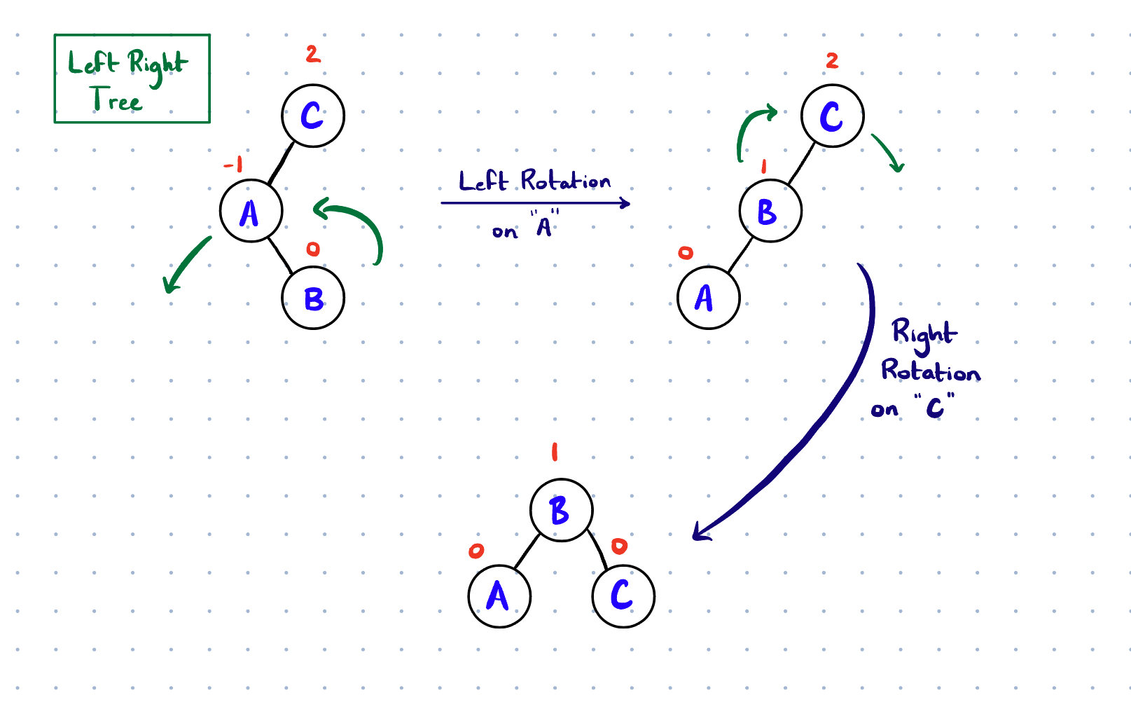

Slide 13
Right Left Rotation (Double)
This rotation is performed when a node is inserted to a the left subtree of a node’s right subtree, leading to an unbalance.
In this case, we perform 2 different (single) rotations.
First, we perform a Right Rotation on the parent node’s child.
Then, we perform a Left Rotation on the parent node (Right Right Case)

Slide 14
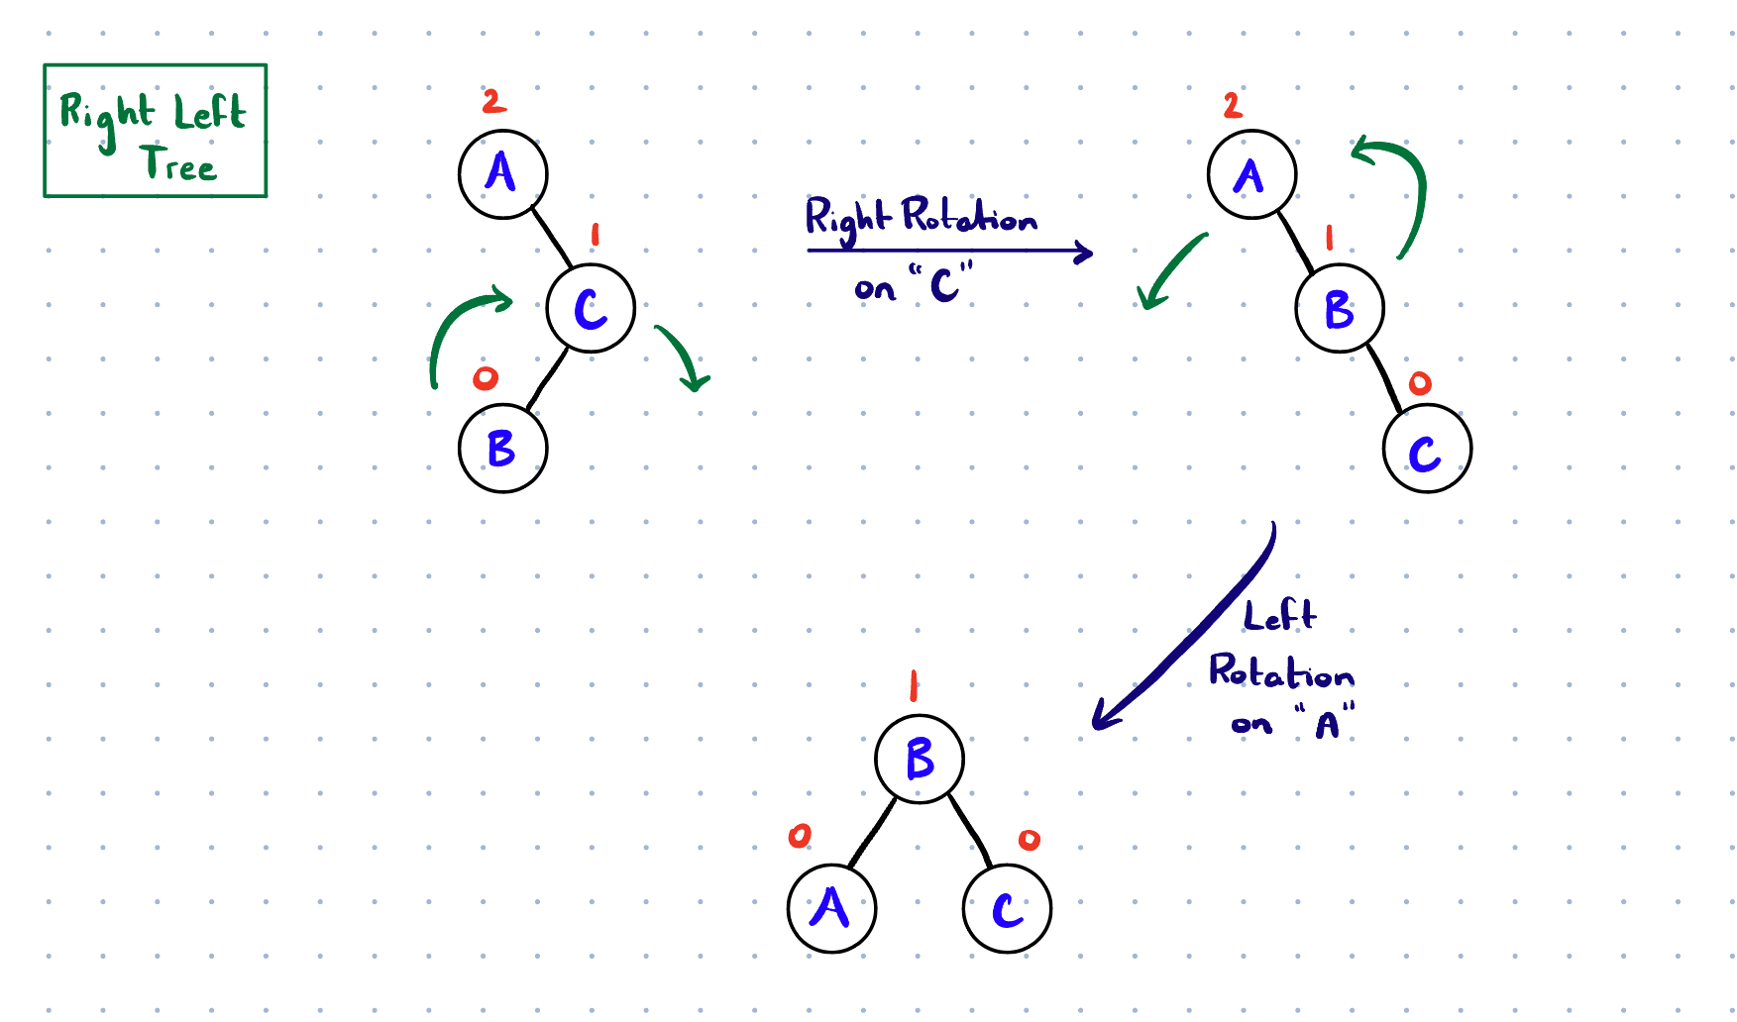

Slide 15
General Outline for Rotations (Tracing)
PROBLEM | FIX
Right Right Tree | Single Left Rotate on Grandparent (Node that Caused Unbalancing)
Left Left Tree | Single Right Rotate on Grandparent
Right Left Tree | Single Right Rotate on Parent , Single Left Rotate on Grandparent
Left Right Tree | Left Rotate on Parent, Right Rotate on Grandparent

Slide 16
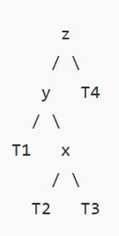
AVL Rotation Practice
Perform the correct rotations on the following tree so that it holds AVL tree properties.
Show what the tree looks like after each rotation that’s needed is made.

Slide 17
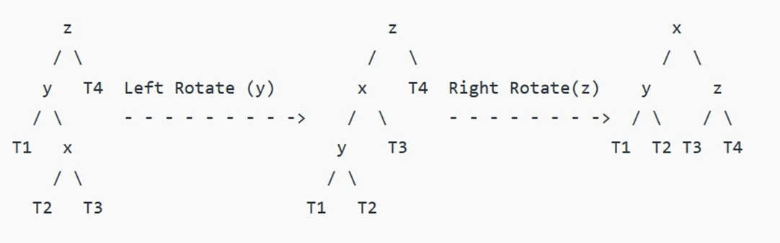
Solution
Note: Look at what happens to T2 after the first rotation. Before the shift, it’s Right Left, respective to y. After the shift, it’s Left Right respective to x.

Slide 18
Worksheet Practice
Work on the worksheet that’s been passed out, it’s a good review to go over in terms of what can be covered on the Final Exam!

